Slide 1

Artificial Intelligence
K-Nearest Neighbors

Slide 2
Introduction
Minkowski Distance
Data Set
Building the KNN Model
Content
knn_predict()
Accuracy
Effect of Varying 'K'
Real World Applications
Conclusion

Slide 3

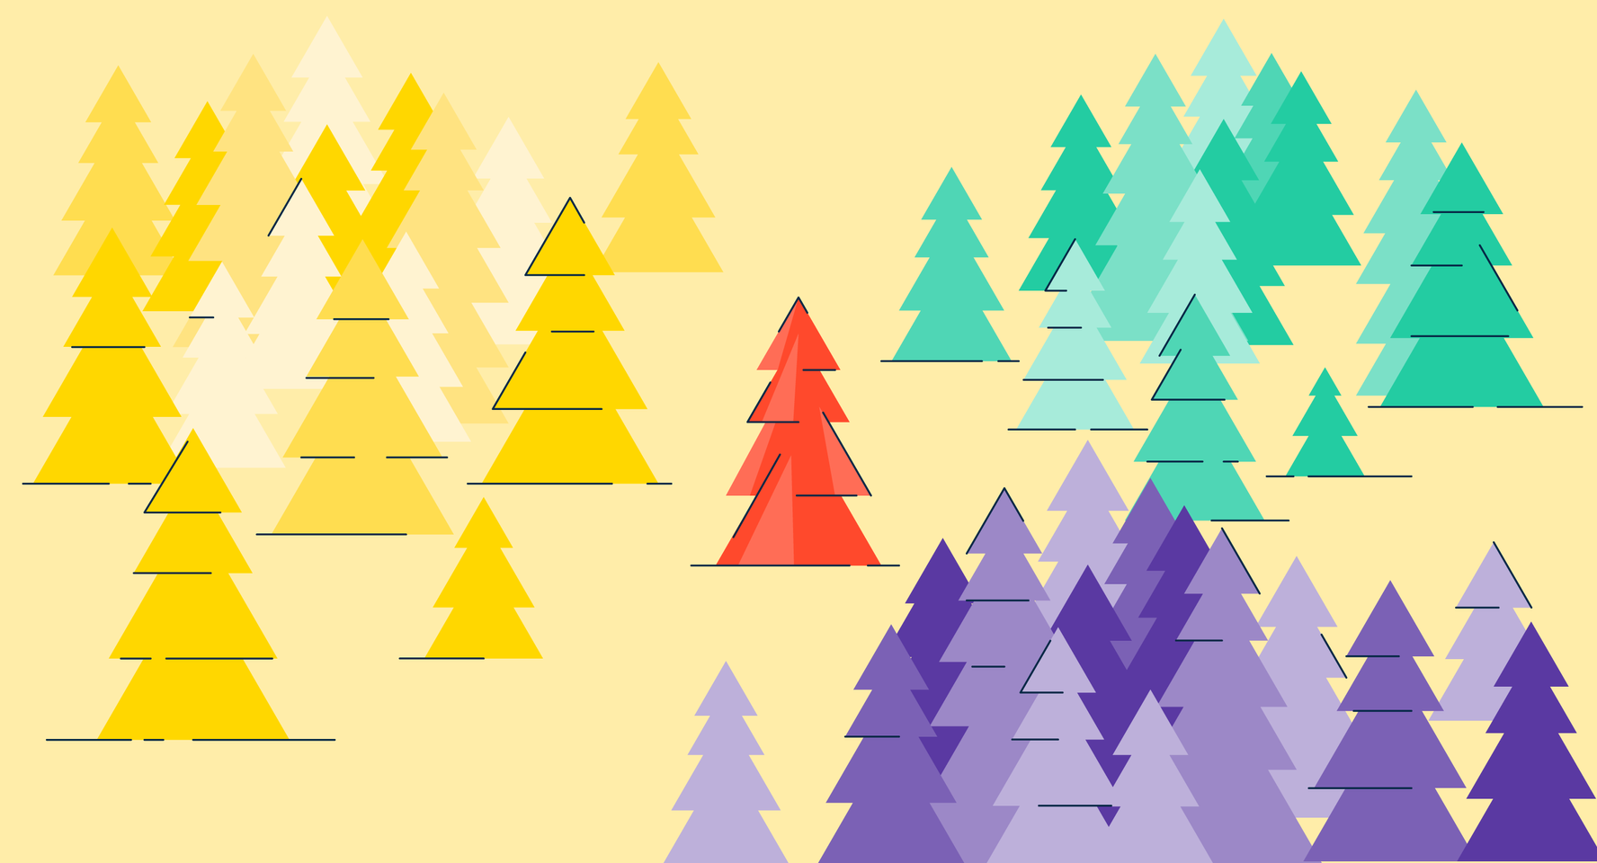
K-Nearest Neighbors
K-Nearest Neighbors (KNN) is a supervised machine learning algorithm that can be used for either regression or classification tasks.
It is non-parametric, which means that the algorithm does not make assumptions about the underlying distributions of the data.

Slide 4


Slide 5
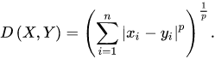
Minkowski Distance
The distance between points is determined by using a generalized formula, known as Minkowski distance, i.e., represented as follows:

Slide 6
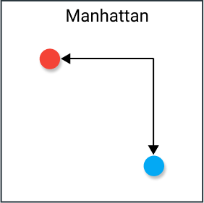
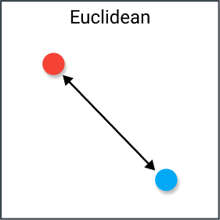

Slide 7
Data Set
Sepal Length
Sepal Width
Petal Length
Petal Width
Measurements
0 = setosa
1 = versicolor
2 = virginica
Species

Slide 8
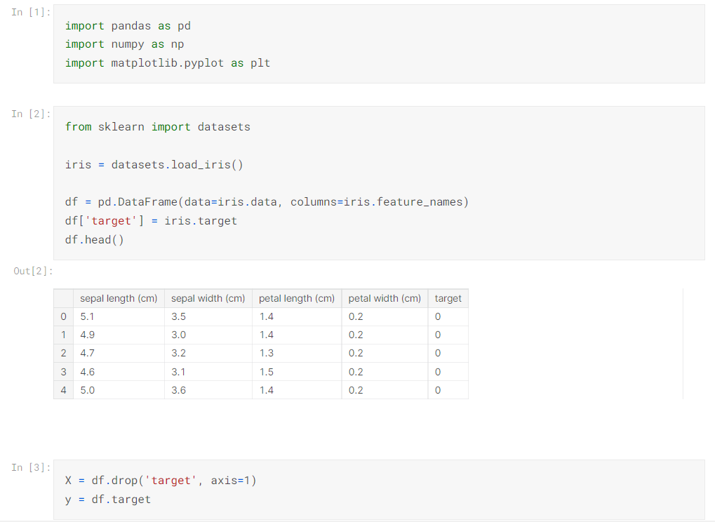

Slide 9
Building the KNN Model
1
2
3
4
Defining a function to calculate distance between two points
Using the distance function to get the distance between a test point and all known data points
Sort distance measurements to find the points closest to the test point
Using majority class labels of those closest points to predict the label of the test point
Repeat Steps 1 to 4 until all the test data points are classified

Slide 10
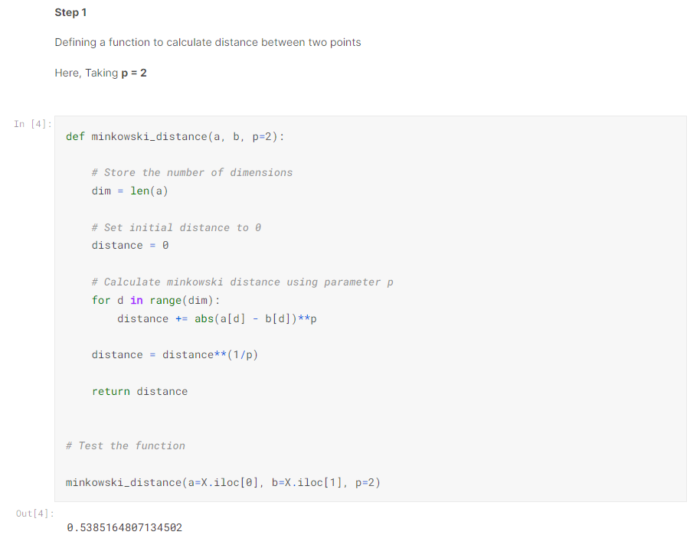

Slide 11
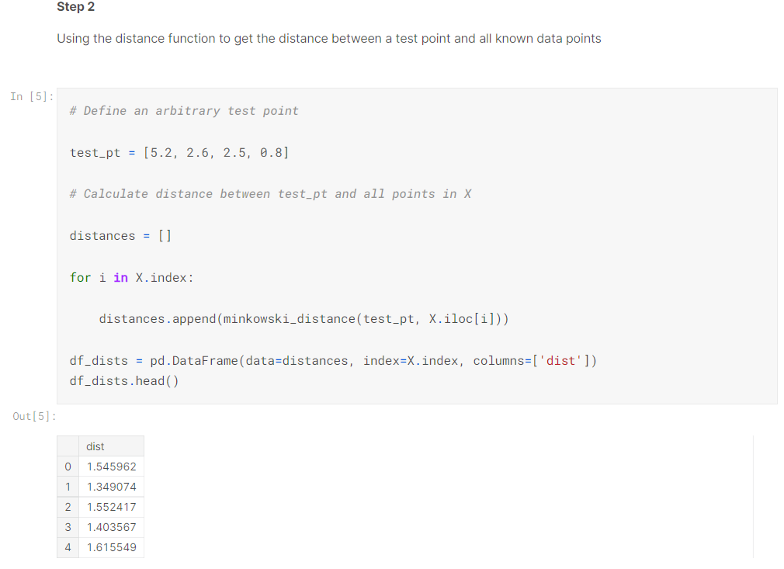

Slide 12
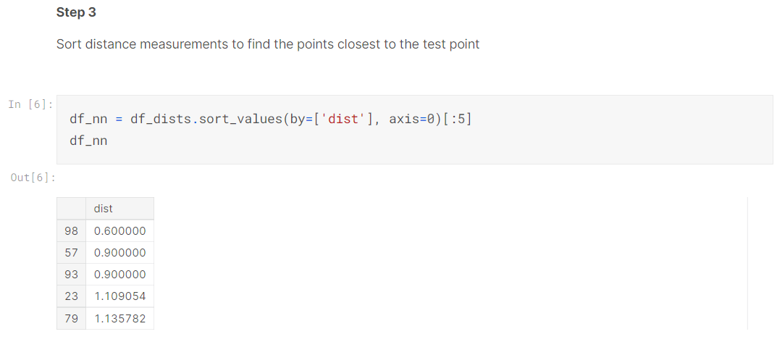

Slide 13
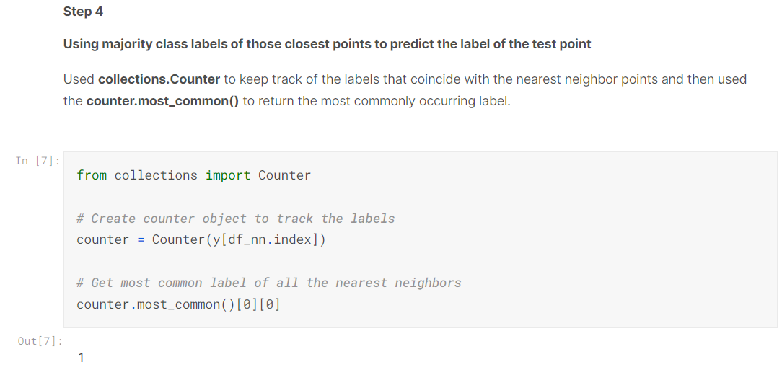

Slide 14
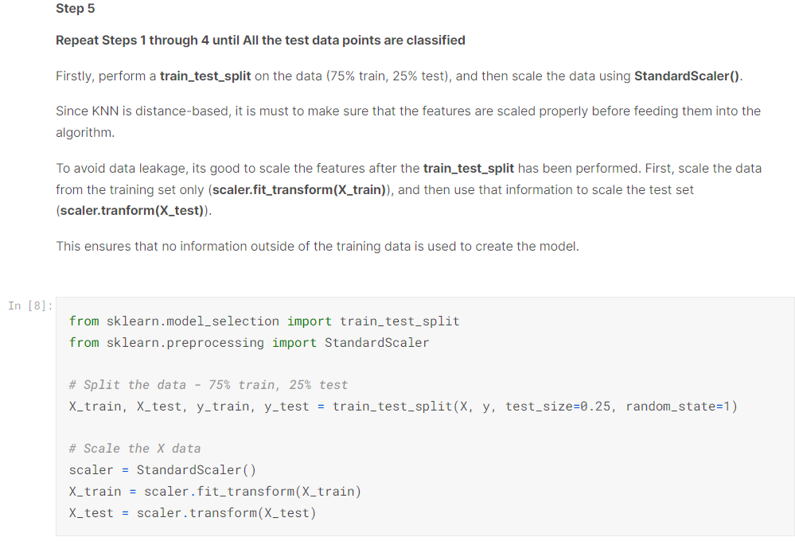

Slide 15
knn_predict()
Function takes in all of the training and test data, k, and p, and returns the predictions my KNN classifier makes for the test set (y_hat_test).
The function should return a list of label predictions containing only 0’s, 1’s and 2’s.

Slide 16
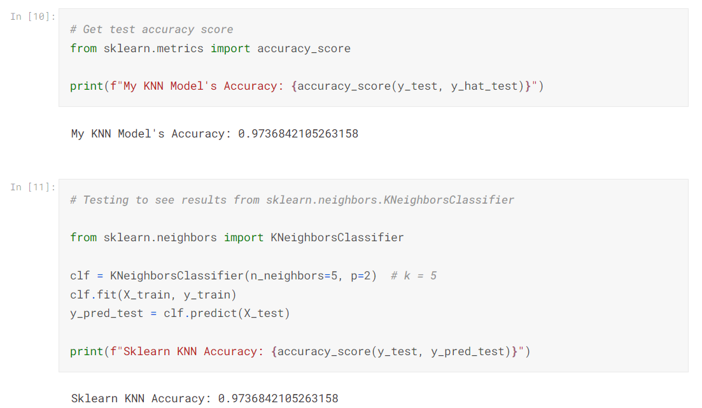

Slide 17
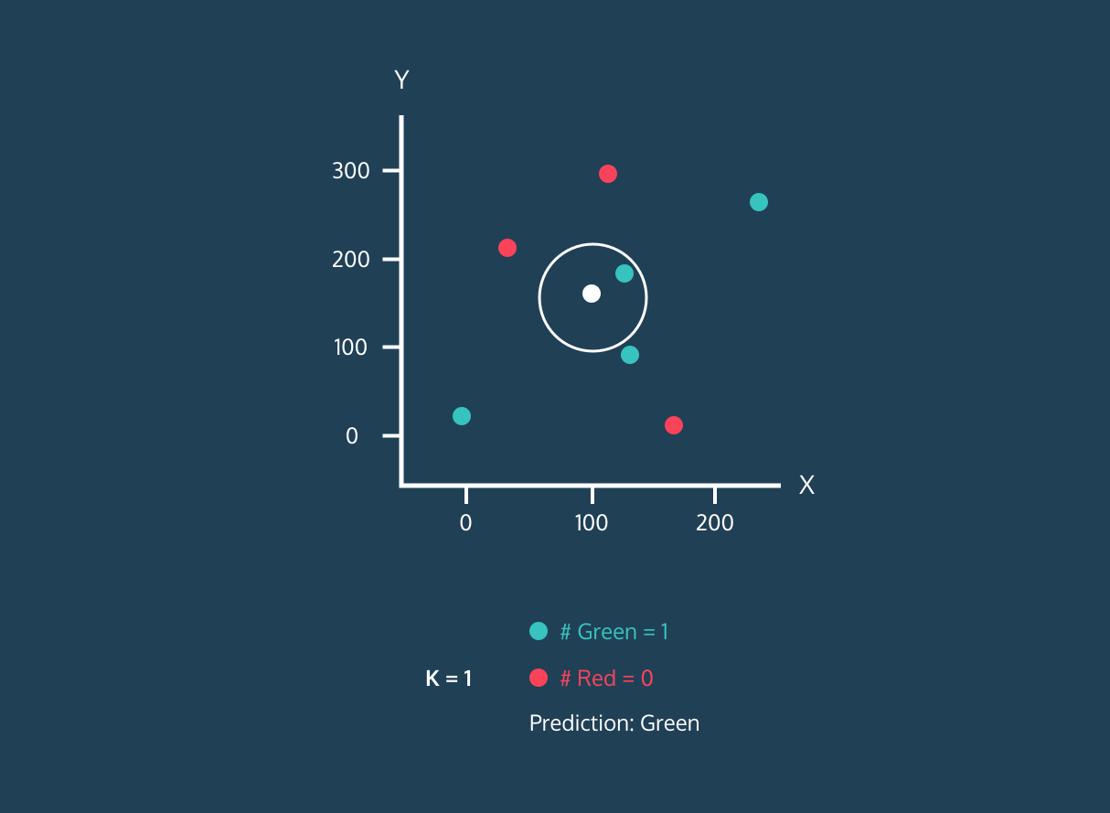

Slide 18
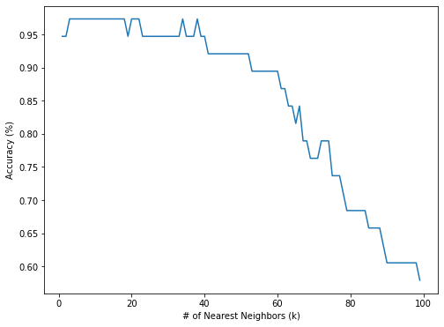
Effect of Varying 'K'

Slide 19





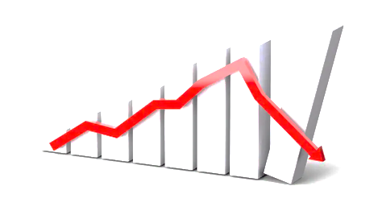




Slide 20
Non-Parametric
Conclusion
&
Features
Works on low-dimension dataset
Based on Feature Similarity
Classification & Regression Algorithm
Supervised Learning Algorithm

Slide 21
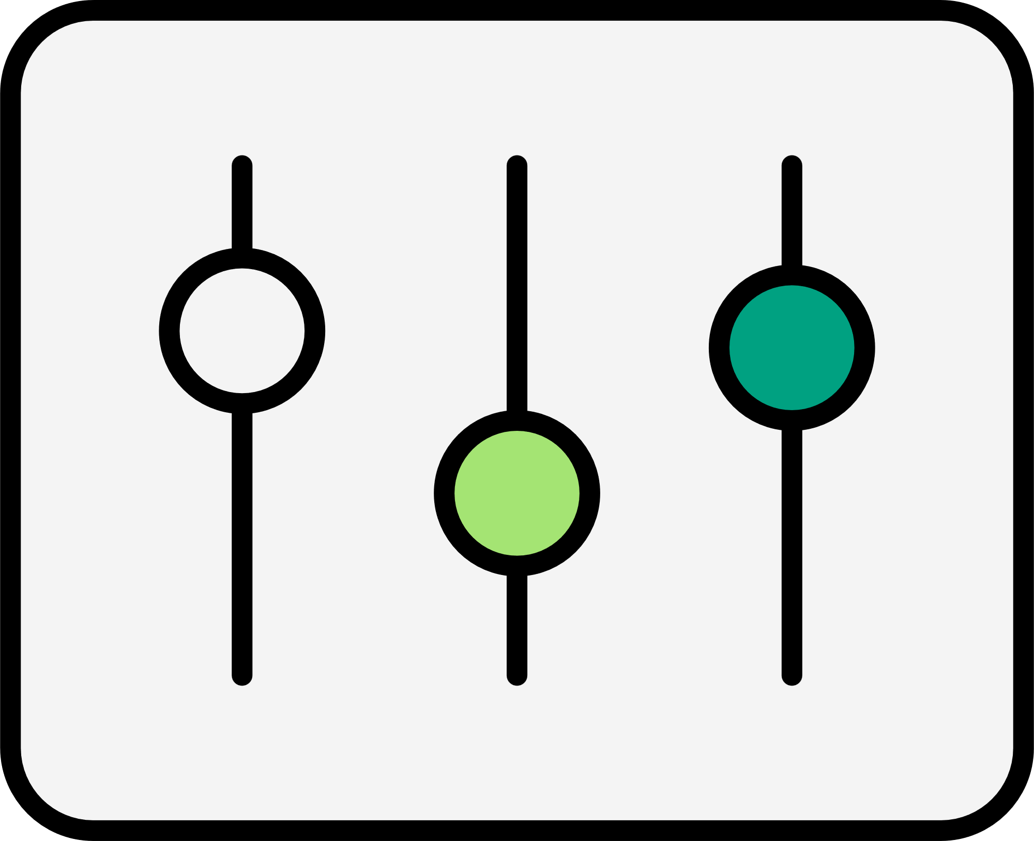














Thank
You
A Presentation by
V I J E E T N I G A M

